Slide 1
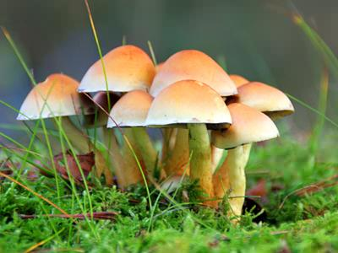
Fungi
General Microbiology Course
B 104
Level 1

Slide 2
Characteristics of Fungi
- Fungi are more closely related to animals than plants
Fungi are heterotrophic:
they use complex organic compounds as sources of energy and carbon, not photosynthesis
Fungi multiply either asexually, sexually, or both
Fungi interact with other organisms by either forming beneficial or mutualistic associations (mycorrhizae and lichens ) or by causing serious infections.
mycorrhiza: a symbiotic association between a fungus and the roots of a vascular plant
lichen: any of many symbiotic organisms, being associations of fungi and algae; often found as white or yellow patches on old walls, etc.

Slide 3
FUNGI (Mycology)
Diverse group of heterotrophs.
Many are ecologically important saprophytes (consume dead and decaying matter)
Others are parasites.
Most are multicellular, but yeasts are unicellular.
Most are aerobes or facultative anaerobes.
Cell walls are made up of chitin (polysaccharide).
Over 100,000 fungal species identified. Only about 100 are human or animal pathogens.
Most human fungal infections are nosocomial and/or occur in immunocompromised individuals (opportunistic infections).
Fungal diseases in plants cause over 1 billion dollars/year in losses.

Slide 4
Fungi
Unicellular
Multicellular
Dimorphic
Yeasts
Molds and Fleshy Fungi
Both

Slide 5
Characteristics of Fungi
1. Yeasts
Unicellular fungi, nonfilamentous, typically oval or spherical cells. Reproduce by mitosis:
Fission yeasts: Divide evenly to produce two new cells (Schizosaccharomyces).
Budding yeasts: Divide unevenly by budding (Saccharomyces).
Budding yeasts can form pseudohypha, a short chain of undetached cells.
Candida albicans invade tissues through pseudohyphae.
Yeasts are facultative anaerobes, which allows them to grow in a variety of environments.
When oxygen is available, they carry out aerobic respiration.
When oxygen is not available, they ferment carbohydrates to produce ethanol and carbon dioxide.

Slide 6
Characteristics of Fungi (Continued)
2. Molds and Fleshy Fungi
Multicellular, filamentous fungi.
Identified by physical appearance, colony characteristics, and reproductive spores.
Thallus: Body of a mold or fleshy fungus. Consists of many hyphae.
Hyphae (Sing: Hypha): Long filaments of cells joined together.
Septate hyphae: Cells are divided by cross-walls (septa).
Coenocytic (Aseptate) hyphae: Long, continuous cells that are not divided by septa.
- Hyphae grow by elongating at the tips.
- Each part of a hypha is capable of growth.
Vegetative Hypha: Portion that obtains nutrients.
Reproductive or Aerial Hypha: Portion connected with reproduction.
Mycelium: Large, visible, filamentous mass made up of many hyphae.

Slide 7
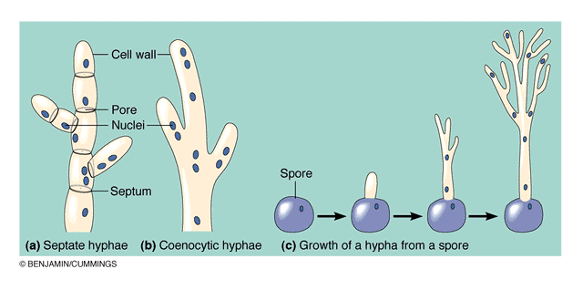
Characteristics of Fungal Hyphae: Septate versus Coenocytic

Slide 8
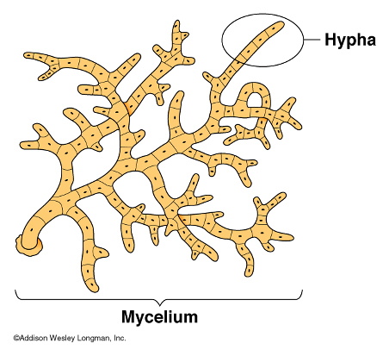
Mycelium: Large, Visible Mass of Hyphae

Slide 9
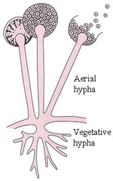
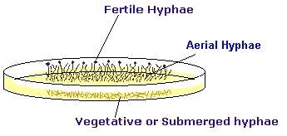
Vegetative and Reproductive or Aerial Hypha

Slide 10
Characteristics of Fungi (Continued)
Dimorphic Fungi
Dimorphic fungi are those fungi that exist either in yeast form or as mold (mycelial form) depending on environmental conditions, physiological conditions of the fungus or the genetic characteristics
Many pathogenic species.
Mold form produces aerial and vegetative hyphae.
Yeast form reproduces by budding.
Dimorphism in pathogenic fungi typically depends on temperature:
At 37ºC: Yeast form.
At 25ºC: Mold form.
Dimorphism in nonpathogenic fungi may depend on other factors: Carbon dioxide concentration.

Slide 11
LIFE CYCLE OF FUNGI
Filamentous fungi can reproduce asexually by fragmentation of their hyphae.
Fungal spores are formed from aerial hyphae and are used for both sexual and asexual reproduction.
1. Asexual spores: Formed by the aerial hyphae of one organism. New organisms are identical to parent.
Conidiospore: Unicellular or multicellular spore that is not enclosed in a sac.
Chlamydospore: Thick-walled spore formed within a hyphal segment.
Sporangiospore: Asexual spore formed within a sac (sporangium).
2. Sexual spores: Formed by the fusion of nuclei from two opposite mating strains of the same species. New organisms are different from both parents.

Slide 12
Ascospores enclosed in a sac-like structure (ascus).
Basidiospores: Spores formed externally on a club shaped sexual structure or base called basidium.

Slide 13
NUTRITIONAL ADAPTATIONS OF FUNGI
Fungi absorb their food, rather than ingesting it.
Fungi grow better at a pH of 5, which is too acidic for most bacteria.
Almost all molds are aerobic. Most yeasts are facultative anaerobes.
Fungi are more resistant to high osmotic pressure than bacteria.
Fungi can grow on substances with very low moisture.
Fungi require less nitrogen than bacteria to grow.
Fungi can break down complex carbohydrates (wood, paper), that most bacteria cannot.

Slide 14
FUNGAL DISEASES
Mycosis:
Any fungal disease. Tend to be chronic because fungi grow slowly.
Mycoses are classified into the following categories:
I. Systemic mycoses: Fungal infections deep within the body. Can affect a number of tissues and organs.
Usually caused by fungi that live in the soil and are inhaled.
Not contagious.
Examples:
Histoplasmosis (Histoplasma capsulatum): Initial infection in lungs. Later spreads through blood to most organs.
Coccidiomycosis (Coccidioides immites): Resembles tuberculosis.

Slide 15
Systemic Mycosis: Histoplasmosis
Disseminated Histoplasma capsulatum, lung infection.
Source: Microbiology Perspectives, 1999.

Slide 16
FUNGAL DISEASES (Continued)
II. Cutaneous mycoses: Fungal infections of the skin, hair, and nails.
Secrete keratinase, an enzyme that degrades keratin.
Infection is transmitted by direct contact or contact with infected hair (hair salon) or cells (nail files, shower floors).
Examples:
Ringworm (Tinea capitis and T. corporis)
Athlete’s foot (Tinea pedis)
Jock itch (Tinea cruris)

Slide 17
Cutaneous Mycosis
Ringworm skin infection: Tinea corporis
Source: Microbiology Perspectives, 1999

Slide 18
Cutaneous Mycosis
Candida albicans infection of the nails.
Source: Microbiology Perspectives, 1999.

Slide 19
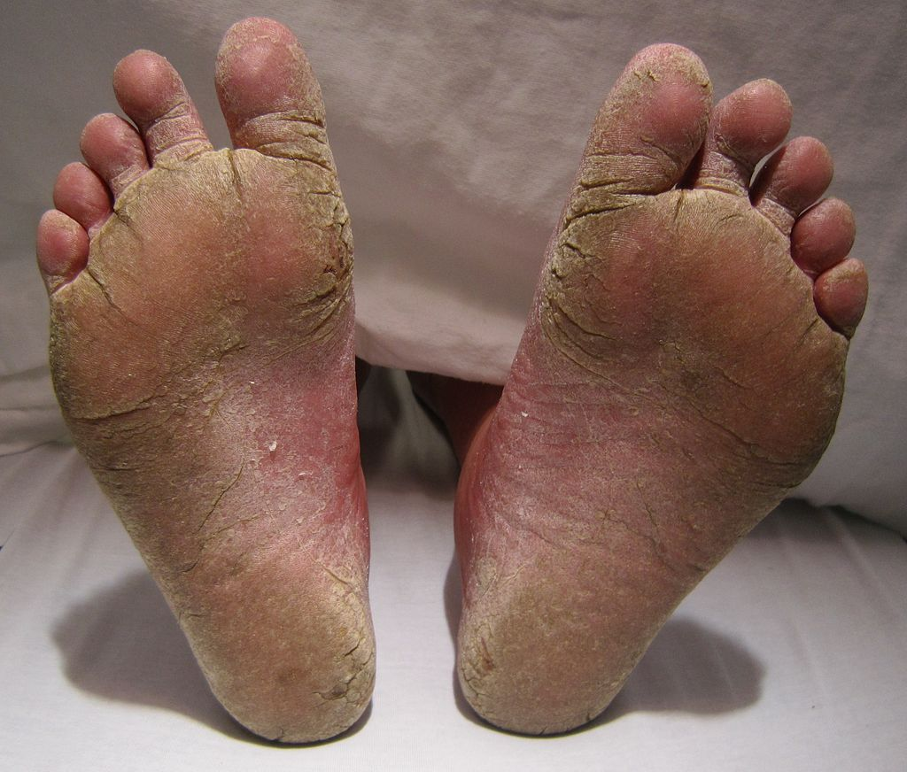
Athlete's foot

Slide 20
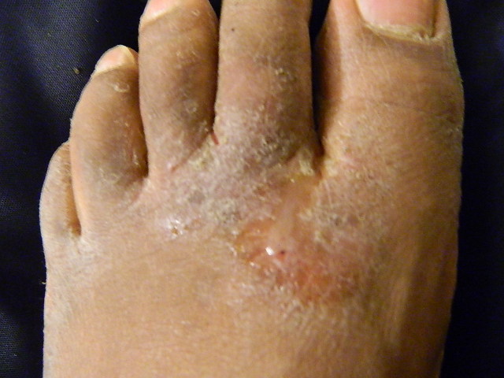
Athlete's foot

Slide 21
FUNGAL DISEASES (Continued)
III. Subcutaneous mycoses: Fungal infections beneath the skin.
Caused by saprophytic fungi that live in soil or on vegetation.
Infection occurs by implantation of spores or mycelial fragments into a skin wound.
Can spread to lymph vessels.
IV. Superficial mycoses: Infections of hair shafts and superficial epidermal cells. Prevalent in tropical climates.

Slide 22
FUNGAL DISEASES (Continued)
Opportunistic mycoses: Caused by organisms that are generally harmless unless individual has weakened defenses:
AIDS and cancer patients
Individuals treated with broad spectrum antibiotics
Very old or very young individuals (newborns).
Examples:
Aspergillosis: Inhalation of Aspergillus spores.
Yeast Infections or Candidiasis: Caused mainly by Candida albicans. Part of normal mouth, esophagus, and vaginal flora.

Slide 23
ECONOMIC IMPORTANCE OF FUNGI
25-50% of harvested fruits and vegetables are damaged by fungi.
Fungal infections of plants are commonly called rots, rusts, blights, wilts, and smuts.
Phytophthora infestans: Caused great potato famine in mid-1800s. Over 1 million people died from starvation in Ireland. Many immigrated to the U.S.
Beneficial fungi:
Fungi have several positive economic effects, such as consuming biodegradable waste, improving soil, acting as symbiotic organisms for various crops, generating antibiotics and other medicines, and being a food source

Slide 24
Fungi used as food:
Mushrooms and morels:- These are edible fungi used as delicious vegetables all over the world.
Yeast:- It mainly consists of carbohydrates, proteins and fats. Yeast food is a rich source of vitamins such a thiamin, riboflavin, nicotinic acid, pantothenic acid, biotin, pyridoxin and amino benzoic acid.
Fungi used in food processing:
Fungi such as species of Aspergillus and Penicillium are employed in the processing of certain food products, baking and cheese industry.
Bread Making:
Saccharomyces cerevisiae is used in bread making.
.

Slide 25
Fungi in medicine:
Fungi were extensively used for their supposed curative properties.
Antibiotics:
Notatin Penicillium notatum,
Penicillin Penicillium chrysogenum
(b)Steroids: Except Myxomycetes wide variety of fungi synthesized steroids.
(c)Vitamins: These include thiamin, Riboflavin, Pantothenic acid, Pyridoxin, Biotin, Choline Ergosterol and Vitamin B and D.
(d)Therapeutic uses of – Extracts of Saccharomyces cerevisiae and Aspergillus niger have proved specific in extreme cases of malignancy

Slide 26
Other examples
Candida oleophila: Prevents fungal growth on harvested fruits.
Genetically engineered yeast strains are used to make proteins (Hepatitis B vaccine).
Taxomyces: Produces anticancer drug taxol.
Trichoderma: Produces cellulose. Used to make fruit juice.

